Slide 1
Why Health Care Providers Should Add Their Own Concerns Before Scoring Parents’ Evaluation of Developmental Status (PEDS)
Notes:
*Patient name within is fictitious and photo is stock photography

Slide 2
Akram Case Example age 12 months

Slide 3
Akram Details
Newly immigrated to the US
No past health records, except for immigrant medical exam vaccinations
Parents’ command of English limited
Used PEDS Online and the translations provided
Sent translations (Arabic) to Language Line and used the Language Line telephone service throughout the visit

Slide 4
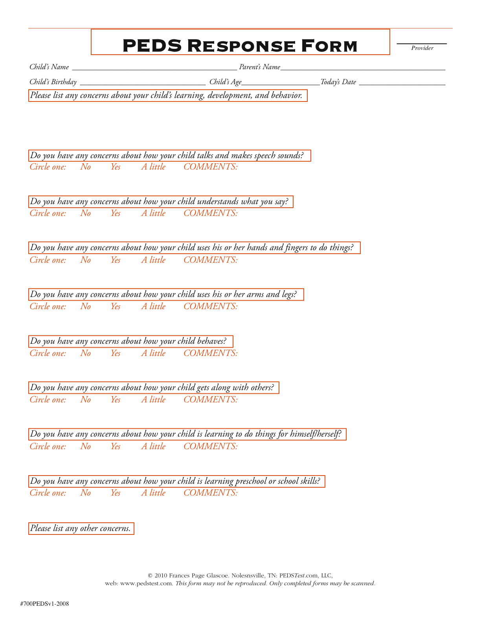
Akram
March 1, 2014
12 months
March 1, 2015
Not walking
Notes:
This is preferred practice—that providers add their own comments and observations before scoring.

Slide 5
RESULTS SO FAR
(based only on parents’ comments on PEDS)
Low Risk on PEDS (Path C)
Recommendations:
1. Provide advice to parents
2. Monitor progress
Notes:
Highlights of PEDS Online recommendations are in the pink box

Slide 6
Comment on Optimal Use of PEDS
We generally don’t worry lots about children who aren’t walking by 12 months of age
But Akram’s doctor noticed a few other things during the physical exam and added those to PEDS
Note that providers are encouraged to add comments and providers’ observations are vital for possible IDEA eligibility
IDEA serves children with conditions likely to result in a delay or disorder in the future –even if delays are not currently manifest.

Slide 7
Akram
March 1, 2014
12 months
March 1, 2015
Not walking
Physician added comments before scoring:
Elevated tone on left side
Extreme right-handedness
Left-hand somewhat fisted
Suspect cerebral palsy?
Cortical dysplasia?
Notes:
This is preferred practice—that providers add their own comments and observations before scoring.

Slide 8
RESULTS
(now including parents + physician comments on PEDS)
Moderate Risk PEDS (Path B)
Recommendations:
Screen further
Include medical evaluations as needed
Notes:
Highlights of PEDS Online recommendations are in the pink box

Slide 9
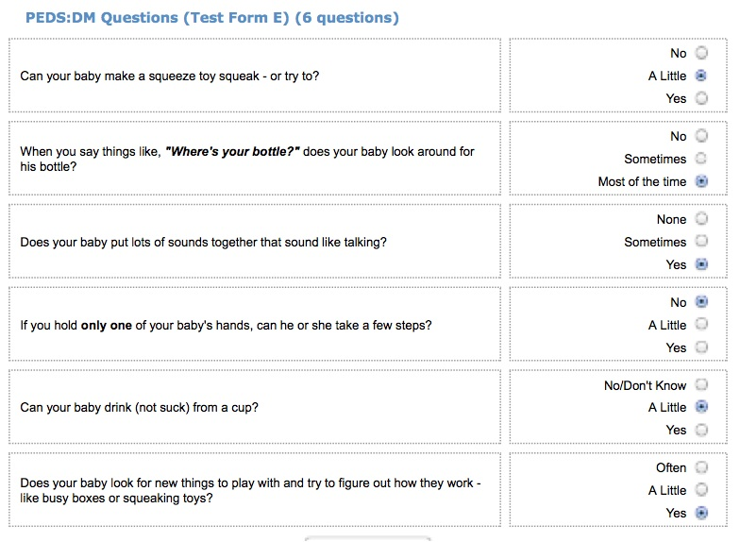
PEDS:DM then administered
Notes:
It may be best to highlight the content of each question, or read them aloud –font too small to be read by audiences

Slide 10
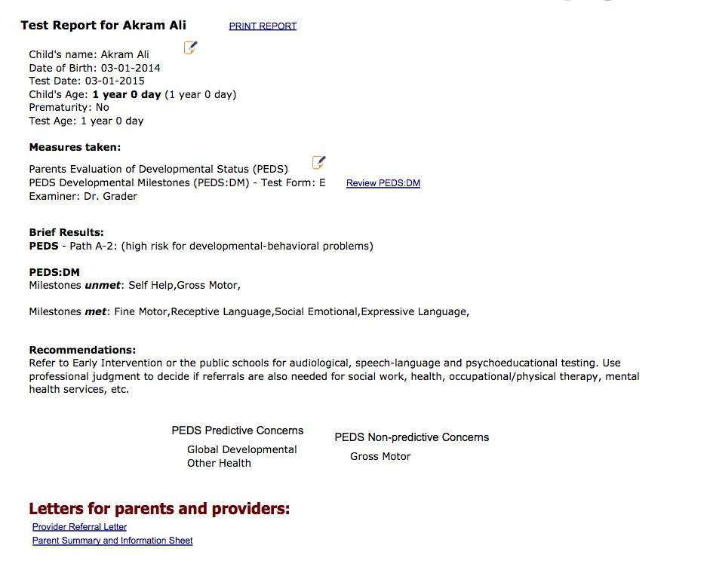
BRIEF RESULTS from PEDS Online with provider comments (plus parent report on the PEDS:DM)
High Risk on PEDS
PEDS:DM:
Unmet milestones: self-help, gross motor
Met milestones: expressive and receptive language, social-emotional
Recommendations:
1. Refer to Early Intervention
2. Refer for additional medical evaluations
Notes:
Highlights of PEDS Online recommendations are in the pink box

Slide 11
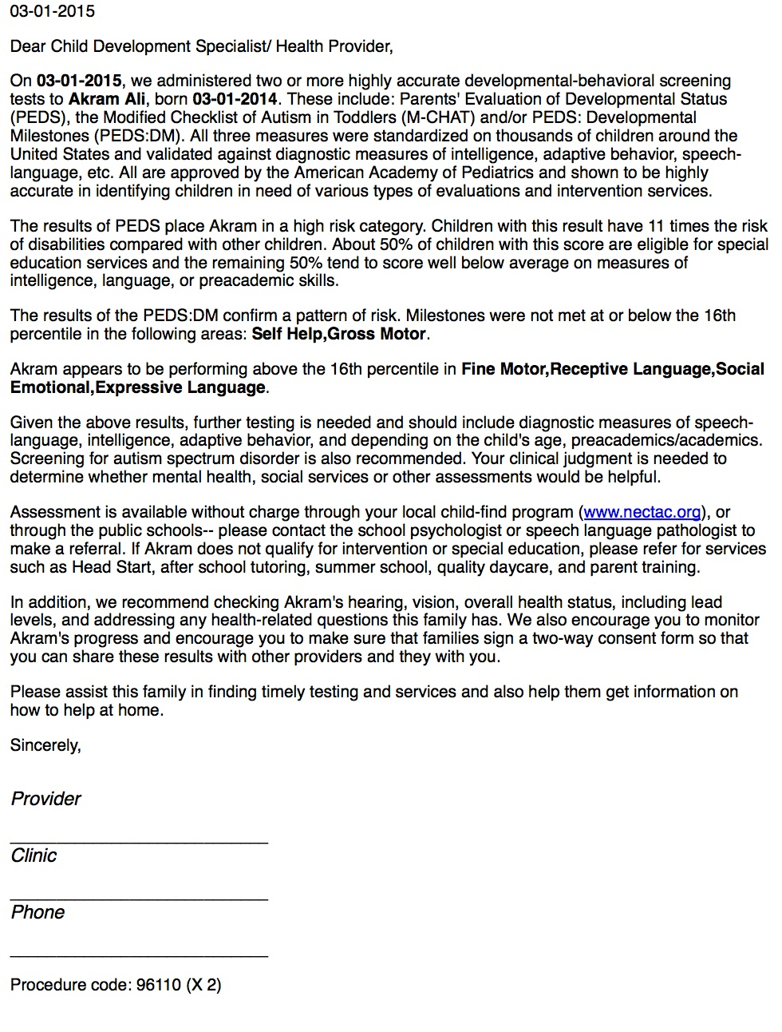
REFERRAL LETTER GENERATED
Explains all results and recommendations
Shows comments on PEDS and q & a on PEDS:DM
Can be emailed, faxed, or snail-mailed
Identifies ICD-9/10 billing and procedure codes
Notes:
Highlights of referral letter PEDS Online generates with ICD-9/10 billing and procedure codes

Slide 12
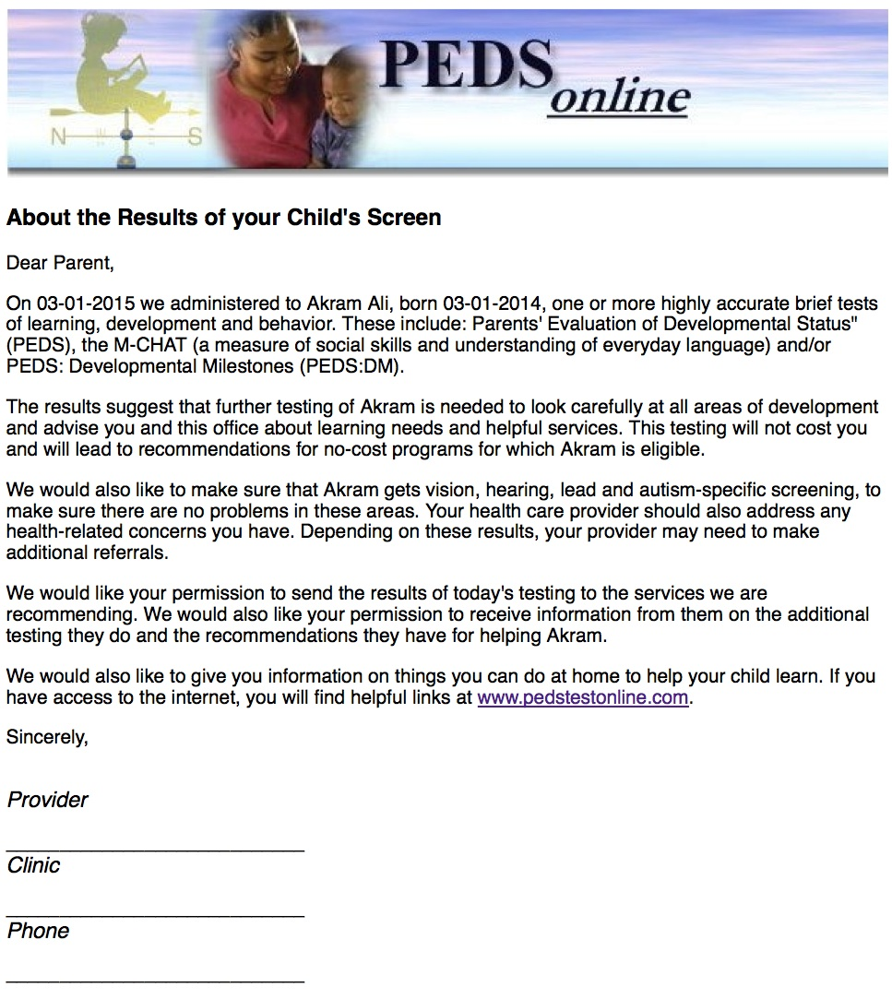
Parent take-home summary report generated—explaining results and recs
Notes:
Per Bright Futures Guidelines!

Slide 13
Akram: Follow-up
Referred to child neurology for MRI
Confirmed neuron migration disorder
Confirmed hemiplegia
Monitoring plan for seizure disorder (commonly co-occuring with cortical dysplasia)
Enrolled in Early Intervention with physical and occupational therapy

Slide 14
Overall Comment - 1
Providers’ comments offer a much needed rationale for referring low/ moderate risk children to IDEA
Helps IDEA identify eligibility criteria
Providers should add comments to PEDS (but not remove any parents’ concerns – these still need addressing)
If PEDS has already been submitted for scoring before the visit, go to www.pedstestonline/myadmin and click on edit record to add comments

Slide 15
Overall Comment - 2
When sending the PEDS Online Referral Letter to IDEA be sure to include all pages including PEDS questions and comments + PEDS:DM questions and parents’ answers!

